Slide 1
Juju
DevOps Distilled

Slide 2
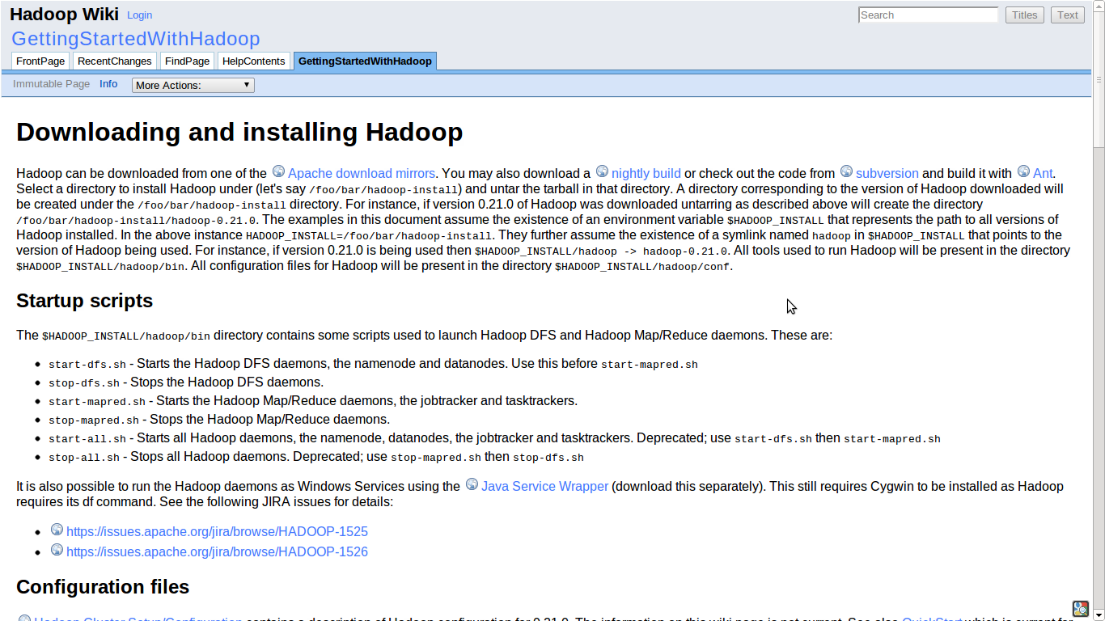

Slide 3
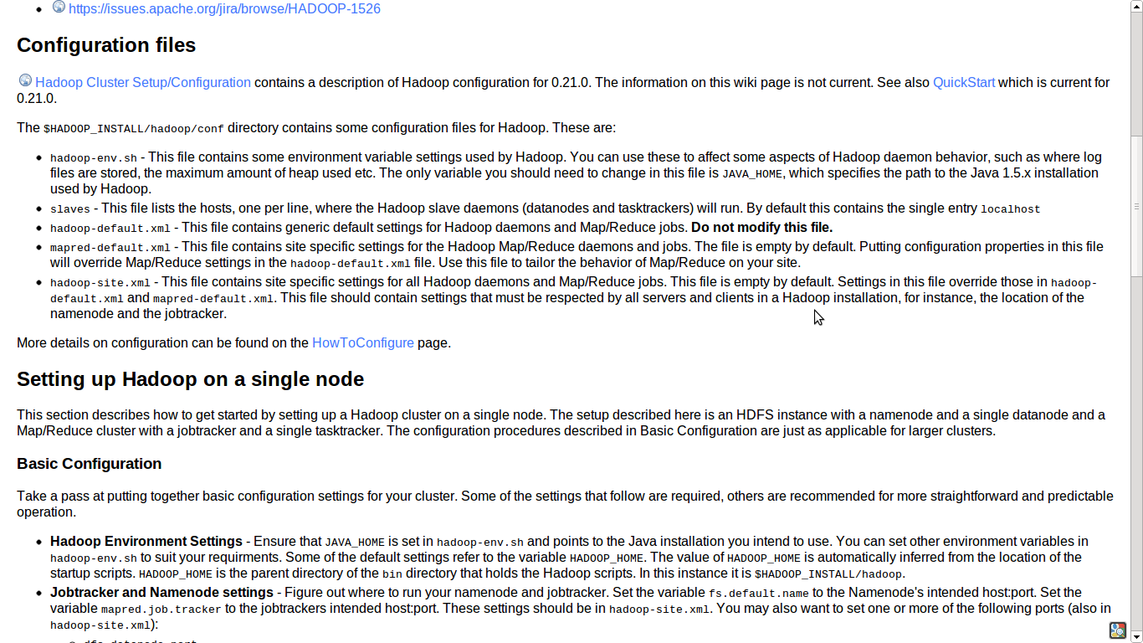

Slide 4
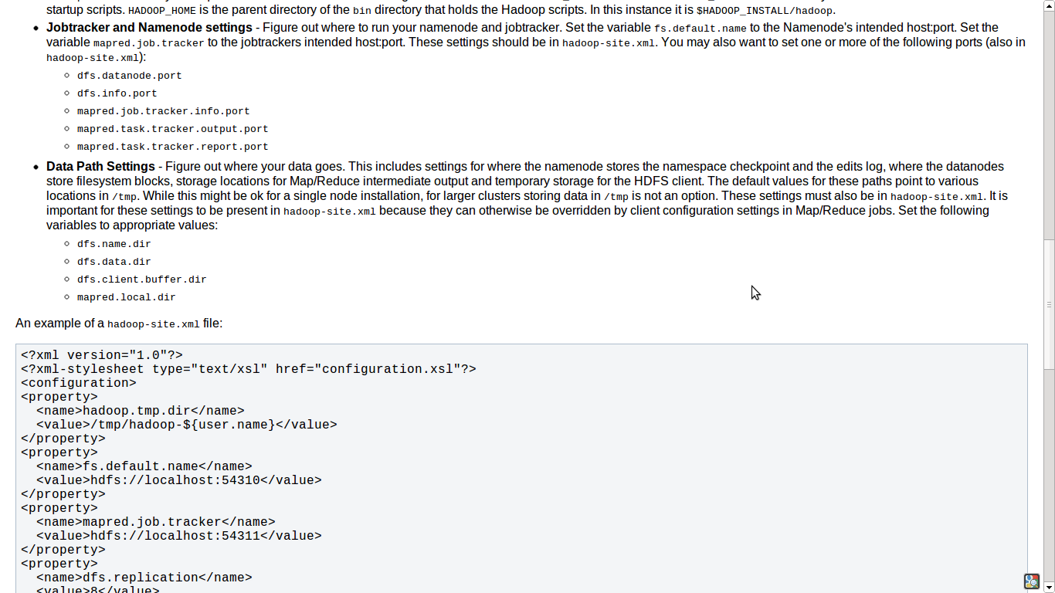

Slide 5
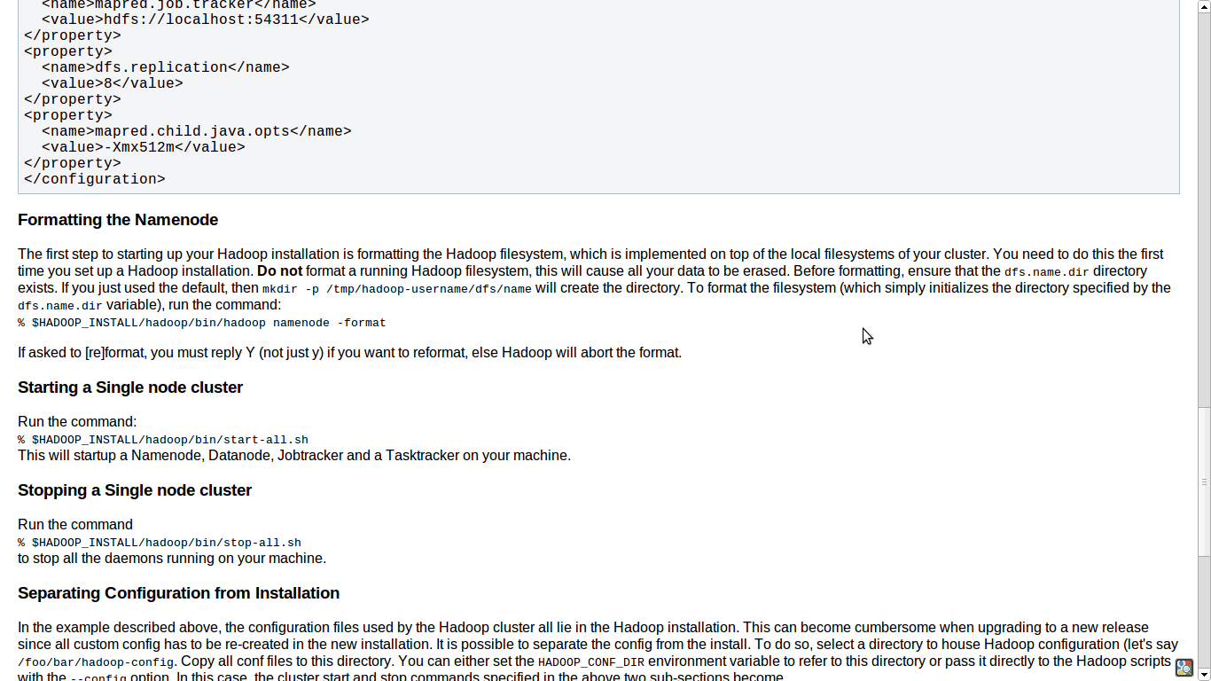

Slide 6
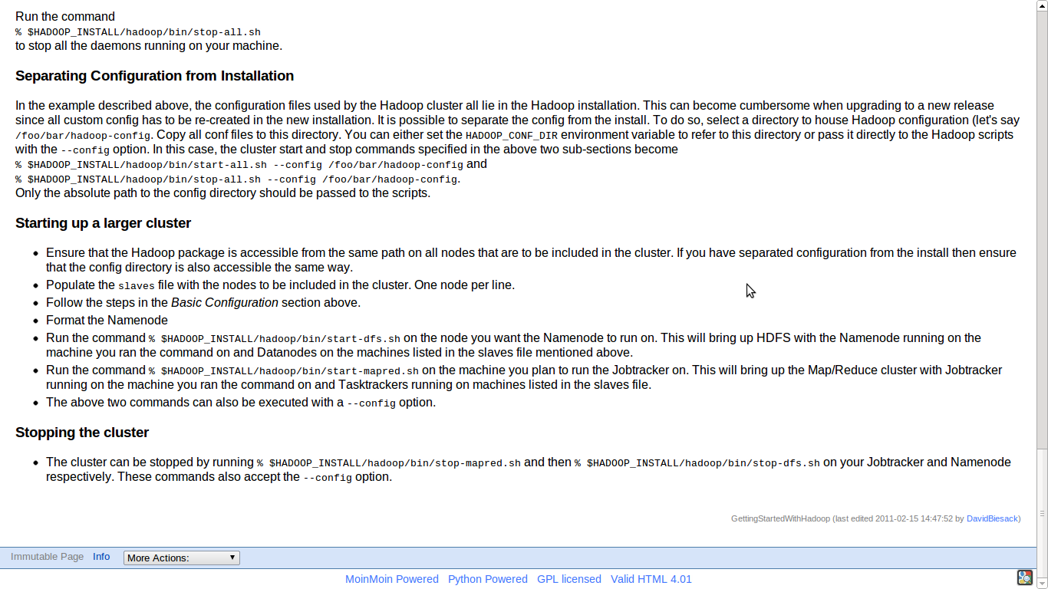

Slide 7
$ juju bootstrap
$ juju deploy hadoop-master
$ juju deploy hadoop-slave
Notes:
How did I do that! (OMG)

Slide 8
Juju Manages Services, not Machines
Devops Distilled
Notes:
We take your expertise and distill it into Juju Charms
Higher level than configuration management.
Only do things once, don't repeat yourself.
Don't repeat others.
Best practice out of the box.
Think of it like an API layer for your deployment.
No restriction on how you want to deploy

Slide 9
Relating services
Notes:
Deployment is easy, a big deal problem, lots of VC there.
BUT You're not done!!!! This is where the meat is.
You don't need to spend all this time investigating how the different parts fit together.
And test it fucking around, just get it done.

Slide 10
$ juju bootstrap
$ juju deploy hadoop-master
$ juju deploy hadoop-slave
$ juju add-relation hadoop-master hadoop-slave

Slide 11
Scaling services

Slide 12
$ juju bootstrap
$ juju deploy hadoop-master
$ juju deploy hadoop-slave
$ juju add-relation hadoop-master hadoop-slave
$ juju add-unit hadoop-slave

Slide 13
$ juju bootstrap
$ juju deploy hadoop-master
$ juju deploy hadoop-slave
$ juju add-relation hadoop-master hadoop-slave
$ juju add-unit hadoop-slave
$ juju add-unit hadoop-slave

Slide 14
$ juju bootstrap
$ juju deploy hadoop-master
$ juju deploy hadoop-slave
$ juju add-relation hadoop-master hadoop-slave
$ juju add-unit hadoop-slave
$ juju add-unit hadoop-slave
$ juju add-unit hadoop-slave

Slide 15
Tools, boring.
Expertise, priceless.

Slide 16
A Community of Charms
Devops Distilled
Notes:
Upstreams, get your code out to ops faster
Ship best practice by default
In whatever language you want
“Lego(tm) for the Cloud”
Reuse charms built by others

